Slide 1
Spatiotemporal Data Management and Analytics Spatial Data Organization I
By Prof Xiaofang Zhou, Dr Lei Li and Dr Pingfu Chao
University of Queensland

Slide 2
Learning Modules
 | Date | Lecture | Lecturer
1 | 22/6 | Course Introduction and RDBMS Review | Prof Xiaofang Zhou
2 | 22/6 | Introduction to Spatial Databases
3 | 23/6 | Spatial Data Organisation | Dr Lei Li
4 | 23/6 | Spatial Query Processing
5 | 24/6 | Managing Spatiotemporal Data | Dr Pingfu Chao
6 | 24/6 | Managing High Dimensional Data | Dr Lei Li
 | 25/6 | 端午节
7 | 26/6 | Advanced Topic: Route Planning in Road Networks | Dr Lei Li
8 | 26/6 | Future Trends, Course Review and Discussions | All
 |  | Revision Period
 | 9 July | Final Report Due

Slide 3
Learning Objectives
What we will cover
Basic principles of managing multidimensional data
2-D as example
How to construct index
Representative data access methods for point, line and polygon data
How to use index
Processing of some spatial operations using data access methods
Point query, Range / Window query, …
Goals
Understand major types of multidimensional data access methods, and their strengths and limits
Understand how point query, window query and join query are processed using various data access methods

Slide 4
Readings
R. Güting, An Introduction to Spatial Database Systems, The VLDB Journal, 3:4, 1994
Oracle Business and Technical White Papers
V. Gaede and O Günther, Multidimensional Access Methods, ACM Computing Surveys, 30:2, 1998
J. Orenstein and F. Manola, PROBE Spatial Data Modeling and Query Processing in an Image Database Application, IEEE Transactions on Software Engineering, 14:5,1988
T. Brinkhoff, H.-P. Kriegel and B. Seeger, Efficient Processing of Spatial Joins Using R-Trees, SIGMOD’93

Slide 5
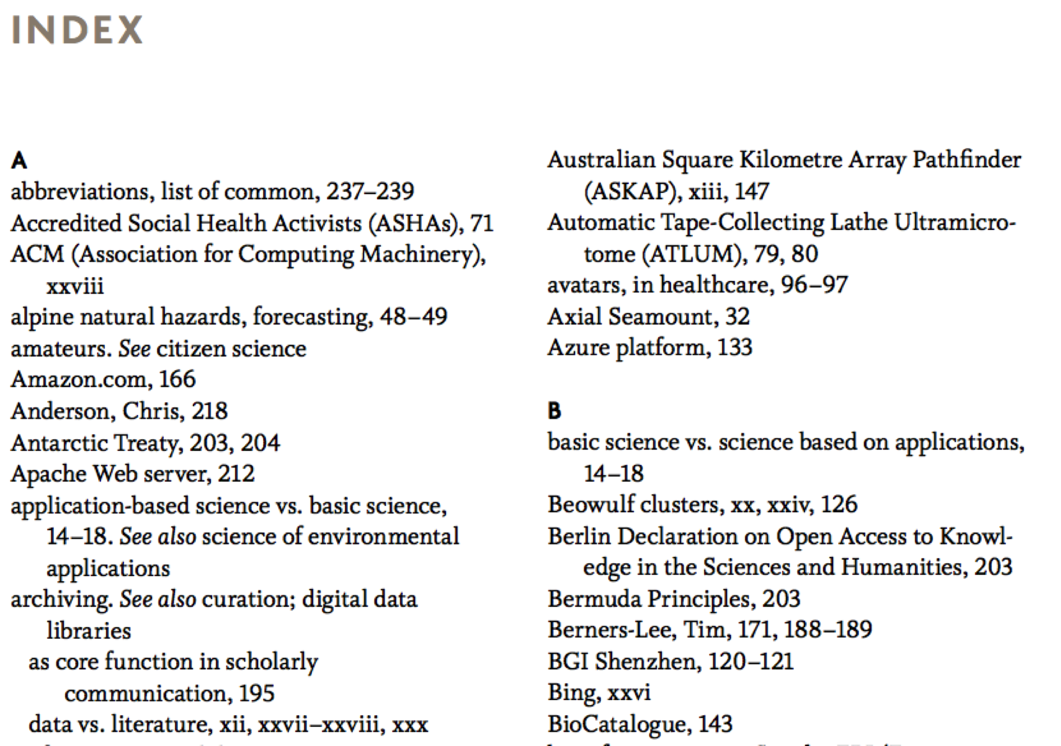
Index

Slide 6
Index
A database index is similar to a book index
Book index: lists important terms in alphabetical order with a list of page number(s) where the term appears
Searching in a book:
Search the book index for a term to find a list of addresses (i.e., page numbers)
Use these addresses to retrieve the specified pages
Search for the term in each page
Otherwise, search through the entire book word by word (≈linear search)

Slide 7
Spatial Indexing
Purpose:
Efficiency in processing spatial selection, join and other spatial operations
Two strategies to organize space and objects
Map spatial objects into 1D space and use a standard index structure (B-tree)
Dedicated external data structures
Basic ideas
Approximation
Bounding box, Grids
Hierarchical Data Organization

Slide 8
Object Approximation
A fundamental idea of spatial indexing is the use of approximation
Continues Approximation
Object centric
Example:
Use of MBRs (Minimum Bounding Rectangles)
R-Tree
Grid Approximation
Space centric
Faster mapping
Uniform / Non-uniform
High-D?
Example:
Quad-Tree

Slide 9
What We Need to Know
For each multidimensional access method:
Motivation
Why it is proposed
Good for what type of data
Points? Line? Polygons?
Operations for creating and maintaining an index
Insert, delete data items
Query operations using an index
Point query and window query
Spatial join queries and other queries

Slide 10
Background Knowledge
Disks and files
Basic indexing methods in relational DBMS
B-Tree
Hashing
Bitmap
Query processing using indexes
What to achieve, and how?

Slide 11
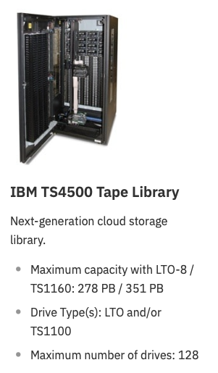
Secondary Storage Device
Magnetic Tape
Still in use???
Cheap per GB: 2 cent
Better durability: 50 years or longer
Suit for backup of PB historical data
Telecom
Energy Efficient
Fast sequential read/write
LTO 8: 12TB 360MB/s
LTO 9: 25TB 708MB/s
LTO 10: 48TB 1100MB/s

Slide 12
Secondary Storage Device
(S)DBMS stores information on hard disks
This has major implications for DBMS design:
READ: transfer data from disk to main memory
WRITE: transfer data from RAM to disk
In the unit of block
512, 1K, 4K, 64M,…
Both are high-cost operations (I/O), so must be planned carefully!
External Memory Complexity: The number of I/Os that need to be performed
Why not store everything in memory?
Costs
Main memory is volatile
PCM: Phase-Change Memory

Slide 13
Magnetic Disks
Main advantage over tapes
Random access
Data is stored and retrieved in units called disk blocks or pages or buckets
Unlike RAM, time to retrieve a page varies depending upon location on disk

Slide 14
Accessing a Disk Block
Time to access (read/write) a disk block:
Seek Time: Moving arms to position disk head on track
Rotational Delay: Waiting for block to rotate under head
5400 / 7200 rpm
Transfer Time: Actually moving data to/from disk surface
Seek Time and Rotational Delay dominate
Key to lower I/O cost: reduce seek/rotation delays! Hardware vs. software solutions?

Slide 15
Index Structure
An index is an auxiliary file that makes it more efficient to search for a record in the data file
An index is usually specified on one field of the file (although it could be specified on several fields)
For another field? Build a new index for it
One form of an index is a file of entries:
<field value, pointer to record>
ordered by field value
The index file occupies less disk blocks than the data file
Because its entries are much smaller
A binary search on the index yields a pointer to the file record
Extra I/O access is needed to fetch data

Slide 16
Data Access Methods
One dimensional
Hashing and B-Trees
Line Data
Segment Tree, Interval Tree
Point data
Hashing: GRID and EXCELL
Hierarchical
Quadtree: point and region quadtrees
kd-Tree
Z-values and B-tree
Polygon data
Transformation: End point mapping and z-values
Overlapping: R-tree and R*-tree
Clipping: R⁺-tree

Slide 17
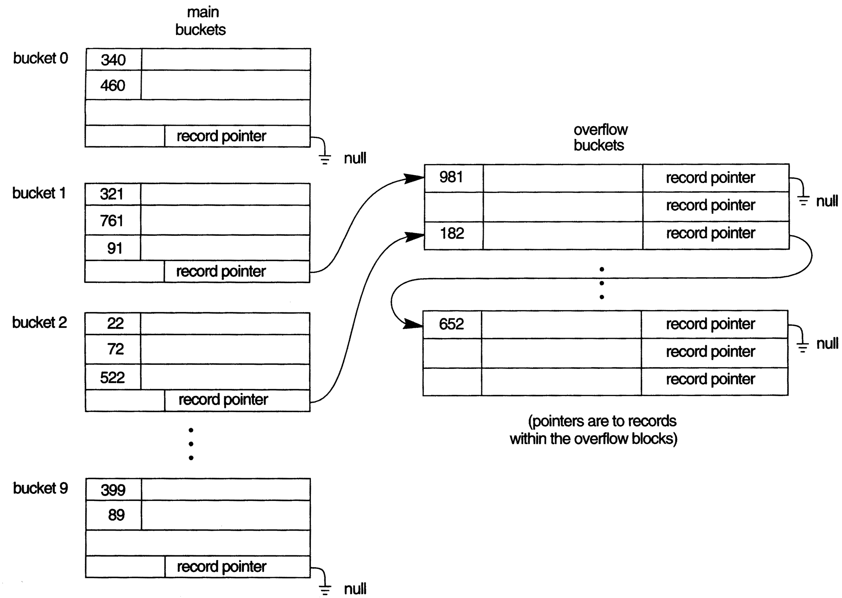
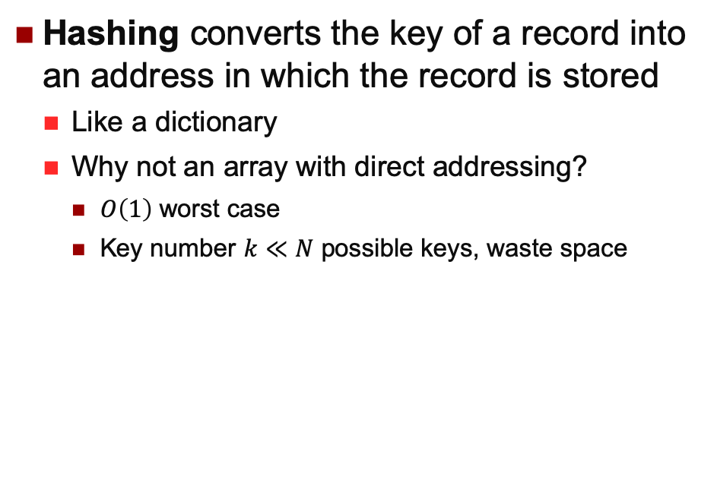
Static Hashing
Hashing converts the key of a record into an address in which the record is stored
Like a dictionary
Why not an array with direct addressing?
$O\left(1\right)$ worst case
Key number $k≪N$ possible keys, waste space

Slide 18
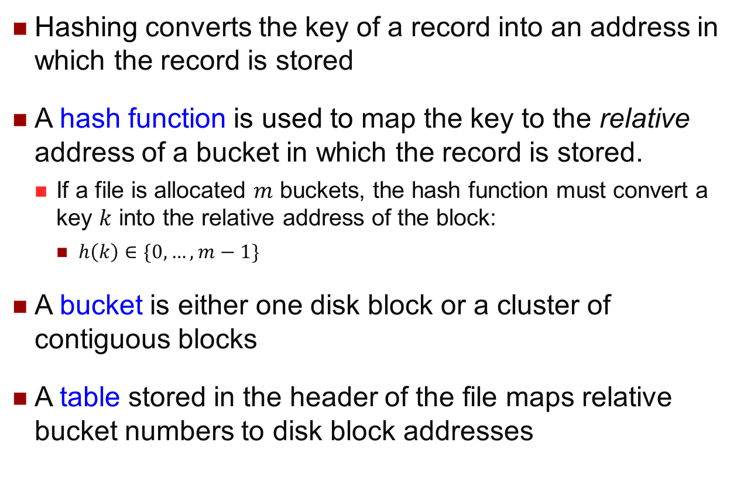
Static Hashing
Hashing converts the key of a record into an address in which the record is stored
A hash function is used to map the key to the relative address of a bucket in which the record is stored.
If a file is allocated $m$ buckets, the hash function must convert a key $k$ into the relative address of the block:
$h\left(k\right)∈\{0,…,m−1\}$
A bucket is either one disk block or a cluster of contiguous blocks
A table stored in the header of the file maps relative bucket numbers to disk block addresses

Slide 19
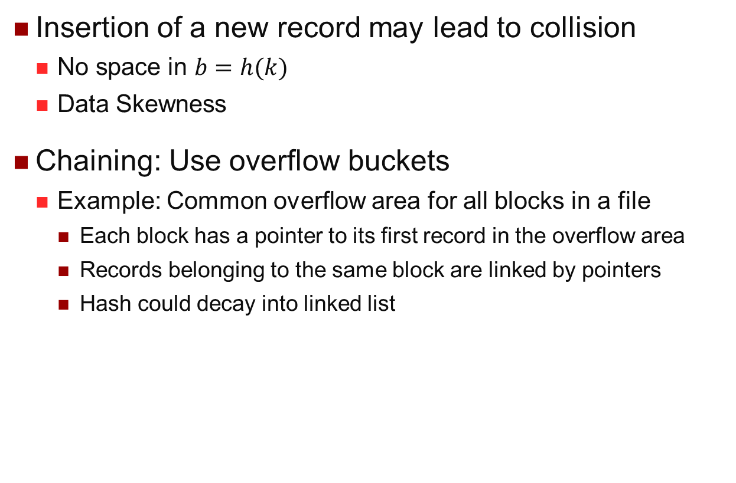
Collision
Insertion of a new record may lead to collision
No space in $b=h(k)$
Data Skewness
Chaining: Use overflow buckets
Example: Common overflow area for all blocks in a file
Each block has a pointer to its first record in the overflow area
Records belonging to the same block are linked by pointers
Hash could decay into linked list
Overflow Area

Slide 20
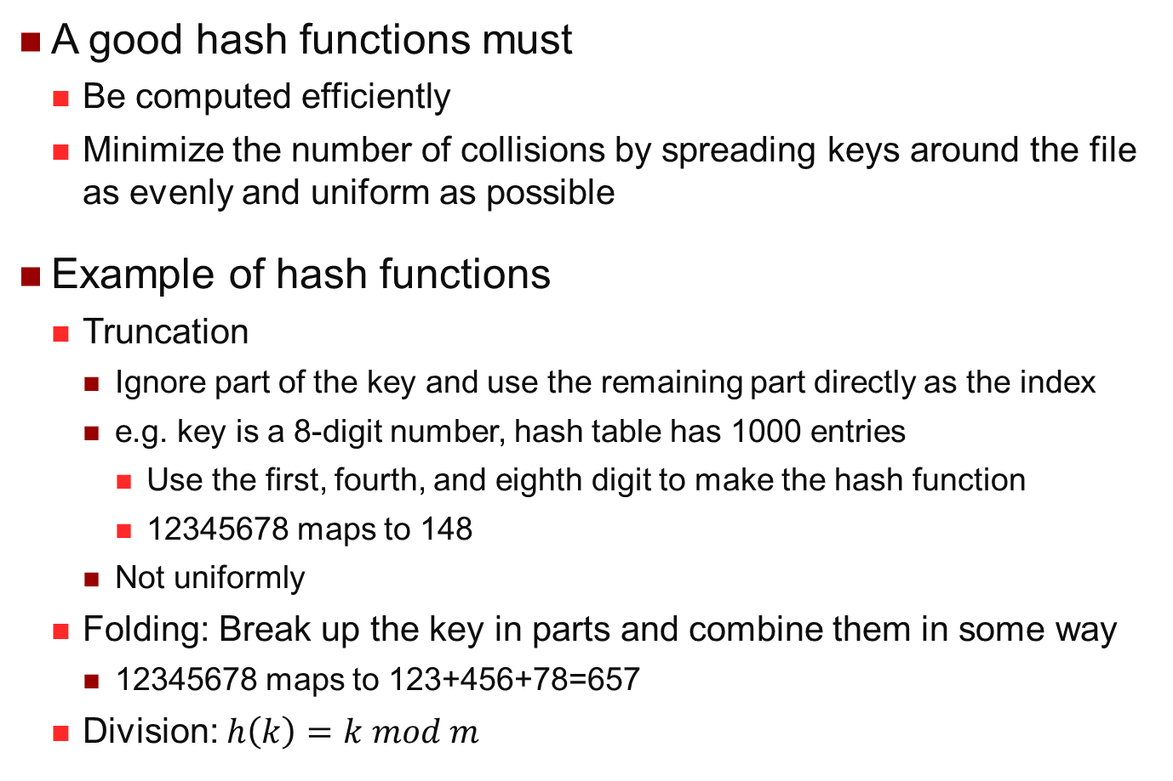
Hashing Functions
A good hash functions must
Be computed efficiently
Minimize the number of collisions by spreading keys around the file as evenly and uniform as possible
Example of hash functions
Truncation
Ignore part of the key and use the remaining part directly as the index
e.g. key is a 8-digit number, hash table has 1000 entries
Use the first, fourth, and eighth digit to make the hash function
12345678 maps to 148
Not uniformly
Folding: Break up the key in parts and combine them in some way
12345678 maps to 123+456+78=657
Division: $h\left(k\right)=k mod m$

Slide 21
Pros and Cons of Hashing
Excellent performance for searching on equality on the key used for hashing
Records are not ordered
Any search other than on equality is very expensive
e.g. Range Query
Prediction of total number of buckets is difficult
Allocate a large space
Estimate a “reasonable” size and periodically reorganize

Slide 22
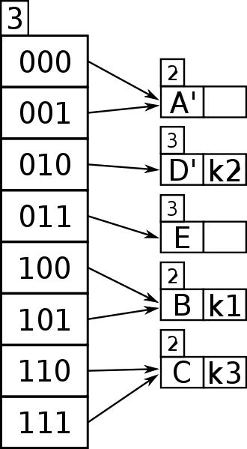
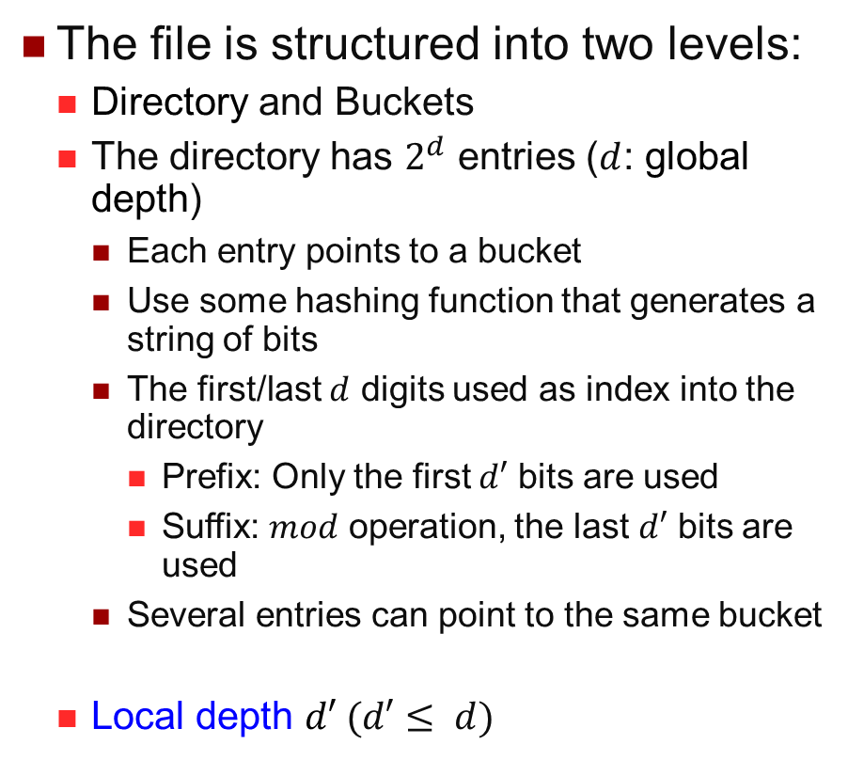
Extendible Hashing
The file is structured into two levels:
Directory and Buckets
The directory has $2^{d}$ entries ($d$: global depth)
Each entry points to a bucket
Use some hashing function that generates a string of bits
The first/last $d$ digits used as index into the directory
Prefix: Only the first $d′$ bits are used
Suffix: $mod$ operation, the last $d′$ bits are used
Several entries can point to the same bucket
Local depth $d′ (d′≤ d)$
Directory
Buckets

Slide 23
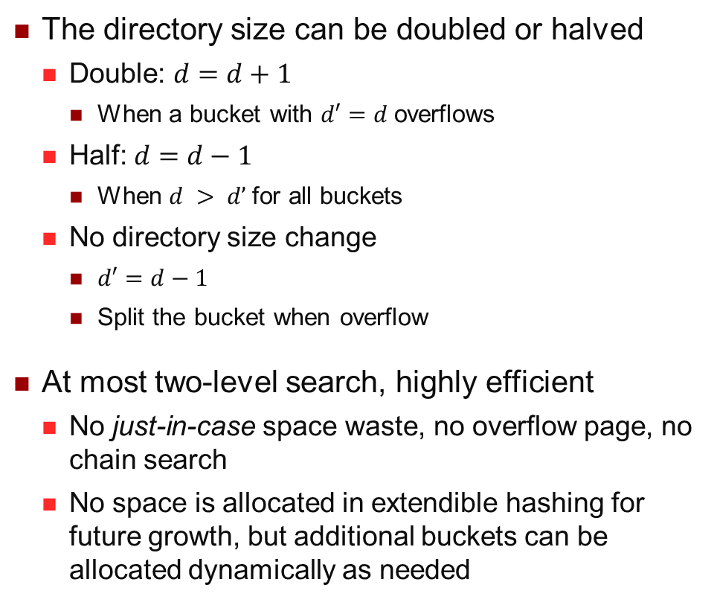
Extendible Hashing Adjustment
The directory size can be doubled or halved
Double: $d=d+1$
When a bucket with $d′=d$overflows
Half: $d=d−1$
When $d > d’$for all buckets
No directory size change
$d′=d−1$
Split the bucket when overflow
At most two-level search, highly efficient
No just-in-case space waste, no overflow page, no chain search
No space is allocated in extendible hashing for future growth, but additional buckets can be allocated dynamically as needed
Example in Tutorial

Slide 24
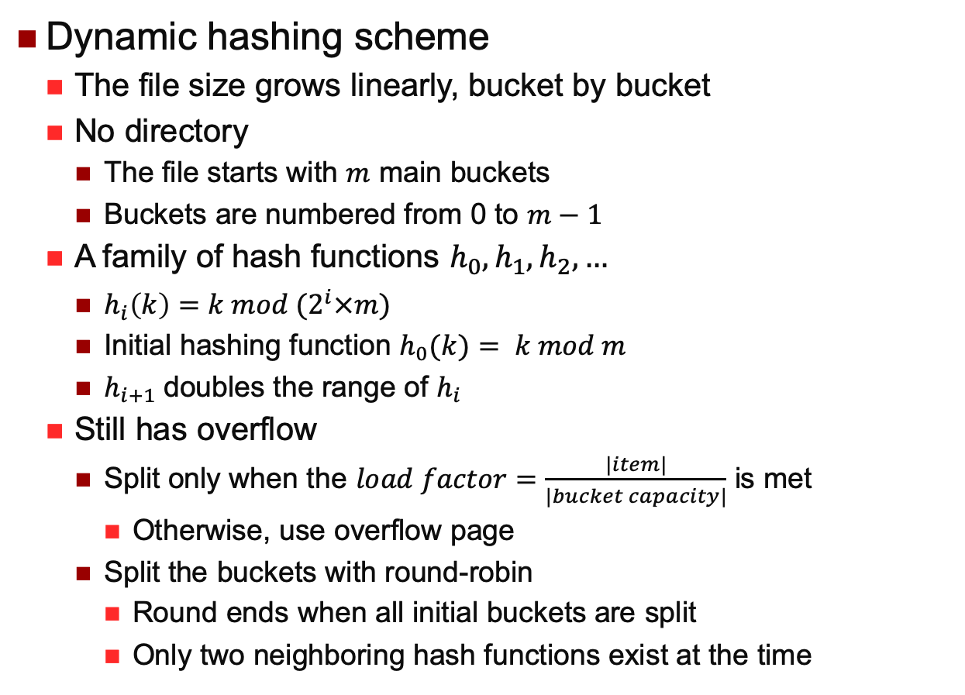
Linear Hashing
Dynamic hashing scheme
The file size grows linearly, bucket by bucket
No directory
The file starts with $m$ main buckets
Buckets are numbered from 0 to $m−1$
A family of hash functions $h_{0},h_{1},h_{2},…$
$h_{i}\left(k\right)=k mod (2^{i}×m)$
Initial hashing function $h_{0}(k)= k mod m$
$h_{i+1}$doubles the range of $h_{i}$
Still has overflow
Split only when the $load factor=\frac{|item|}{|bucket capacity|}$ is met
Otherwise, use overflow page
Split the buckets with round-robin
Round ends when all initial buckets are split
Only two neighboring hash functions exist at the time

Slide 25
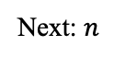
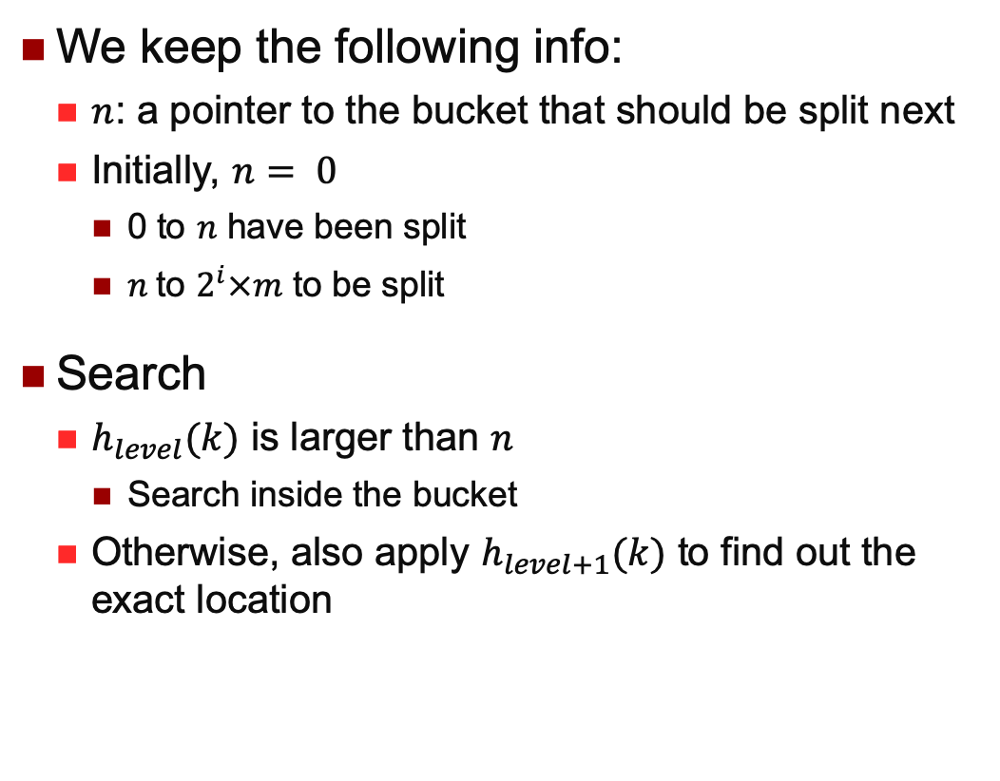
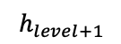
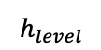
Linear Hashing
We keep the following info:
$n$: a pointer to the bucket that should be split next
Initially, $n= 0$
0 to $n$ have been split
$n$to $2^{i}×m$ to be split
Search
$h_{level}(k)$ is larger than $n$
Search inside the bucket
Otherwise, also apply $h_{level+1}(k)$ to find out the exact location
Split
Next: $n$
$$h_{level}$$
To Split
$$h_{level+1}$$

Slide 26
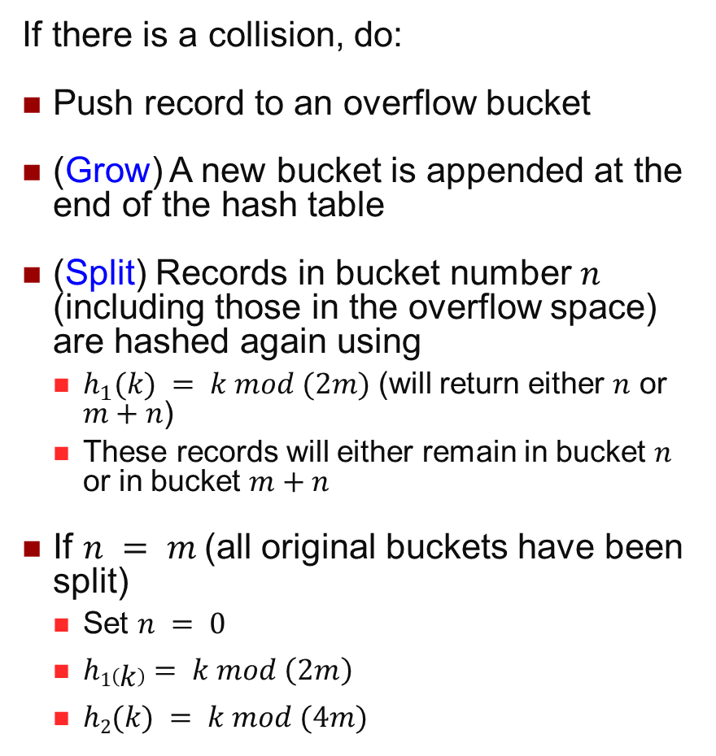
Insertion of a Record
If there is a collision, do:
Push record to an overflow bucket
(Grow) A new bucket is appended at the end of the hash table
(Split) Records in bucket number $n$ (including those in the overflow space) are hashed again using
$h_{1}(k) = k mod (2m)$ (will return either $n$ or $m+n$)
These records will either remain in bucket $n$ or in bucket $m+n$
If $n = m$(all original buckets have been split)
Set $n = 0$
$h1\left(k\right)= k mod \left(2m\right)$
$h2(k) = k mod (4m)$
Split
Next: $n$
$$h_{level}$$
To Split
$$h_{level+1}$$

Slide 27
Linear Hashing
Advantage
The file size grows linearly, bucket by bucket
Disadvantage
No guarantee that a split relieves the overloaded bucket
Still requires overflow buckets and chaining

Slide 28
Hashing Summary
Best for equality search, bad for range search
Static Hashing can lead to long overflow chain
Extendible Hashing avoids overflow by splitting a full bucket when a new data entry is added
Directory to keep track of buckets, doubles periodically
Can be large with skewed data
Linear Hashing avoids directory by splitting buckets round-robin, and using overflow pages
Overflow pages not likely to be long
Space utilization could be lower than Extendible Hashing

Slide 29
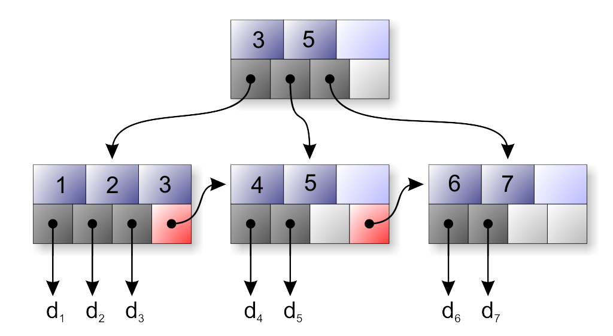
About B-Tree
What does “B” stands for?
How to perform a search for a given key value?
How to insert a value?
Any overhead?
When to create a B-tree index, and on what attributes?
…B-tree and B⁺-tree: what’s the difference?
Notes:
B-tree: internal nodes are real data values
B+-tree: data only stored at leave nodes, which are linked for sequential scan

Slide 30
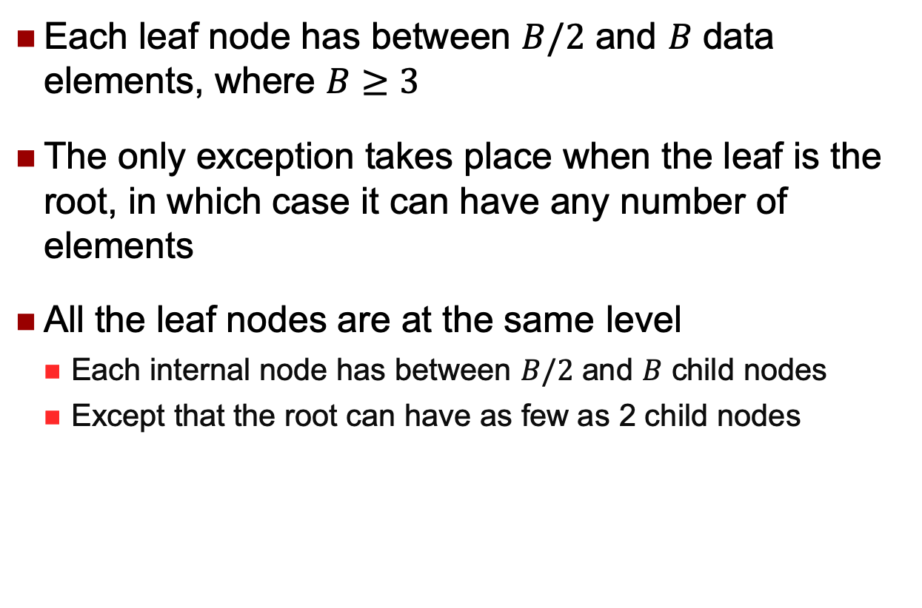
B-Tree
Each leaf node has between $B/2$ and $B$ data elements, where $B≥3$
The only exception takes place when the leaf is the root, in which case it can have any number of elements
All the leaf nodes are at the same level
Each internal node has between $B/2$ and $B$ child nodes
Except that the root can have as few as 2 child nodes

Slide 31
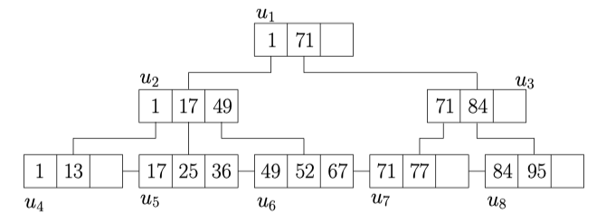
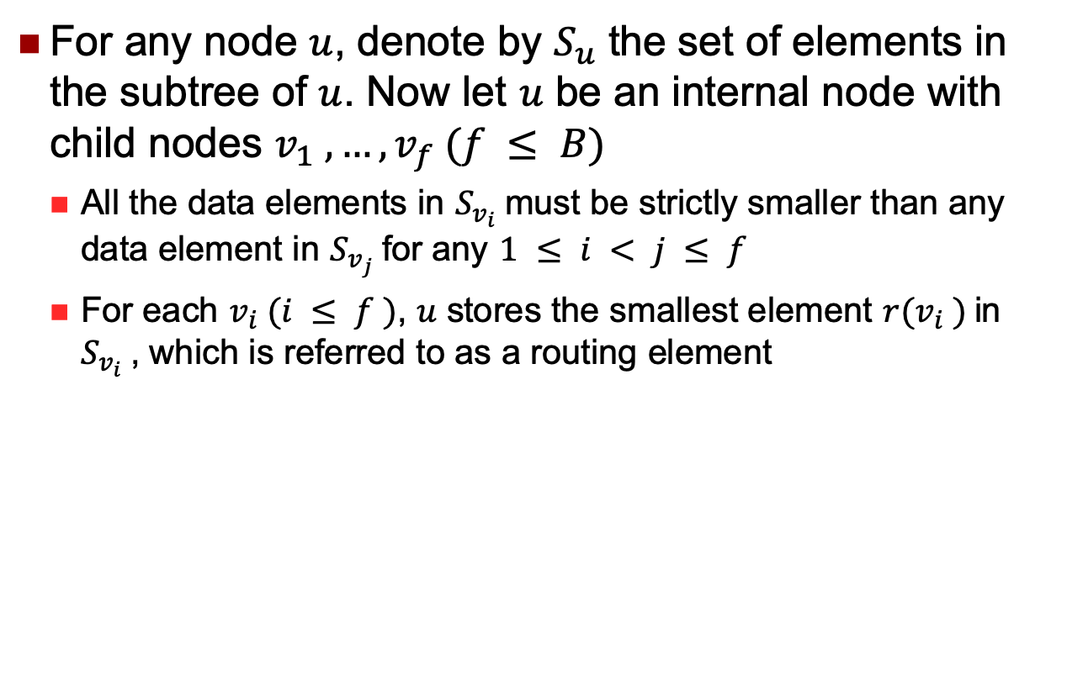
B-Tree Structure
For any node $u$, denote by $S_{u}$ the set of elements in the subtree of $u$. Now let $u$ be an internal node with child nodes $v_{1} , …, v_{f} (f ≤ B)$
All the data elements in $S_{v_{i}}$must be strictly smaller than any data element in $S_{v_{j}}$for any $1 ≤ i < j ≤ f$
For each $v_{i} (i ≤ f )$, $u$ stores the smallest element $r(v_{i} )$in $S_{v_{i}}$, which is referred to as a routing element

Slide 32
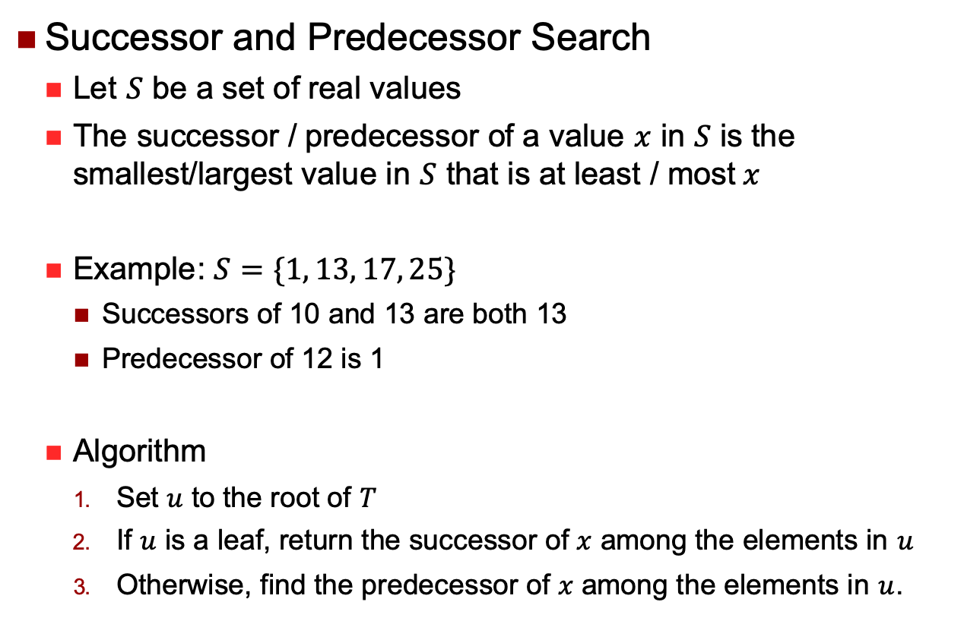
B-Tree Successor and Predecessor Search
Successor and Predecessor Search
Let $S$ be a set of real values
The successor / predecessor of a value $x$ in $S$ is the smallest/largest value in $S$ that is at least / most$x$
Example: $S=\{1, 13, 17, 25\}$
Successors of 10 and 13 are both 13
Predecessor of 12 is 1
Algorithm
Set $u$ to the root of $T$
If $u$ is a leaf, return the successor of $x$ among the elements in $u$
Otherwise, find the predecessor of $x$ among the elements in $u$.

Slide 33
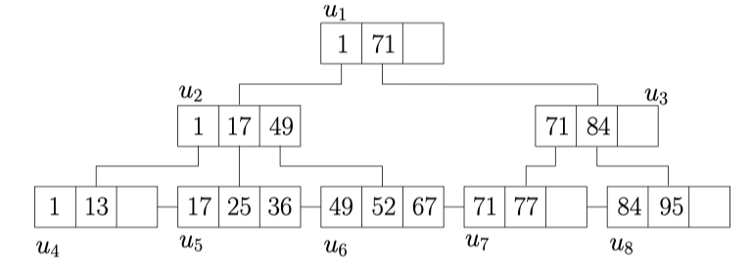
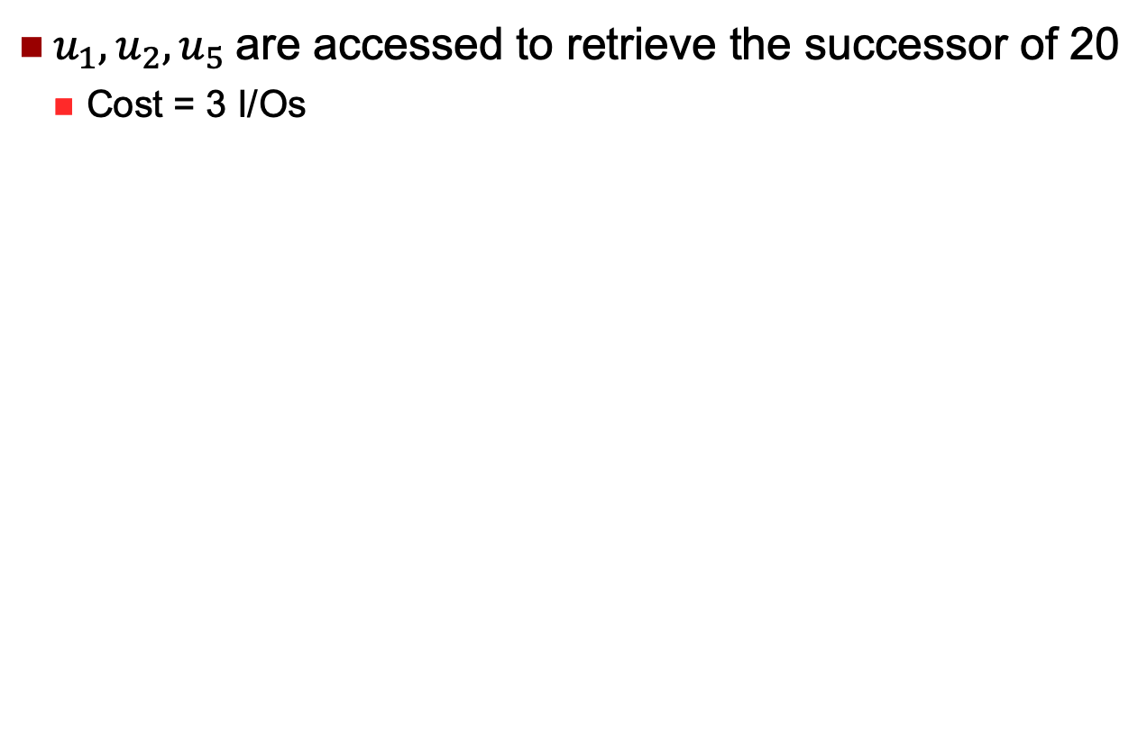
B-Tree Successor and Predecessor Search
$u_{1}, u_{2}, u_{5}$are accessed to retrieve the successor of 20
Cost = 3 I/Os

Slide 34
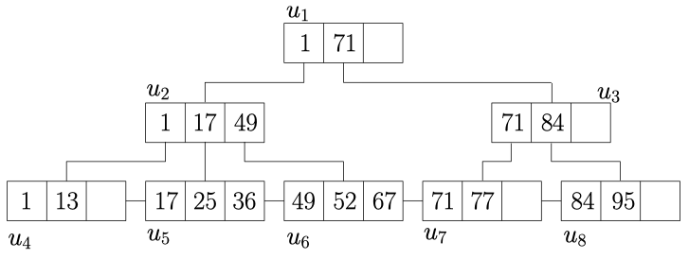
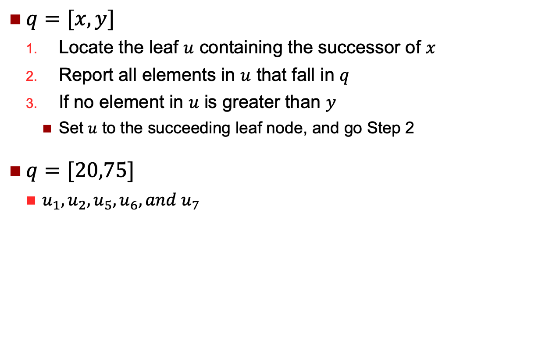
B-Tree Range Query
$q=[x,y]$
Locate the leaf $u$ containing the successor of $x$
Report all elements in $u$ that fall in $q$
If no element in $u$ is greater than $y$
Set $u$ to the succeeding leaf node, and go Step 2
$q=[20,75]$
$u_{1}, u_{2}, u_{5}, u_{6}, and u_{7}$

Slide 35
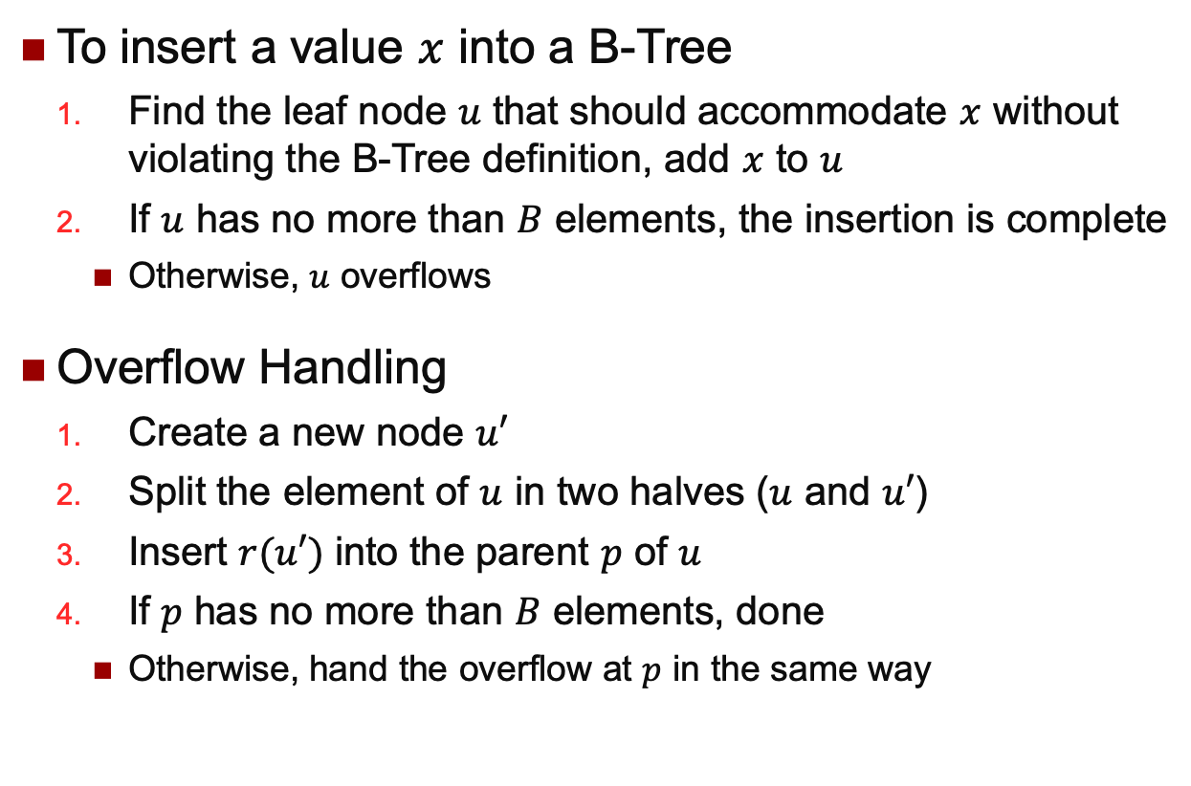
B-Tree Insertion
To insert a value $x$ into a B-Tree
Find the leaf node $u$ that should accommodate $x$ without violating the B-Tree definition, add $x$ to $u$
If $u$ has no more than $B$ elements, the insertion is complete
Otherwise, $u$ overflows
Overflow Handling
Create a new node $u′$
Split the element of $u$ in two halves ($u$ and $u′$)
Insert $r(u′)$ into the parent $p$ of $u$
If $p$ has no more than $B$ elements, done
Otherwise, hand the overflow at $p$ in the same way

Slide 36
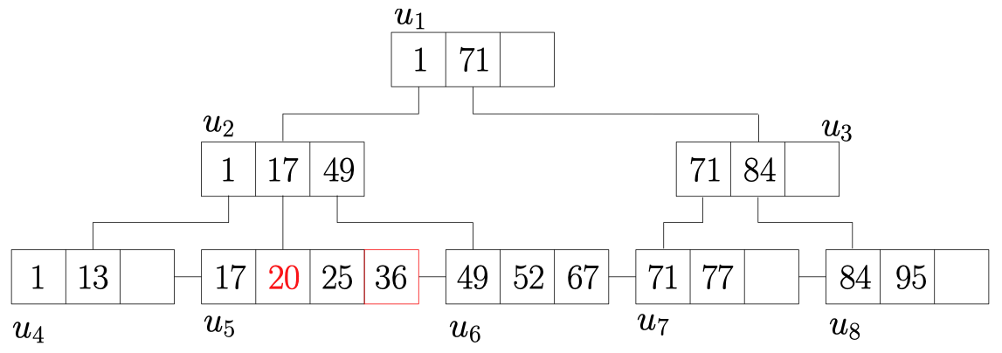
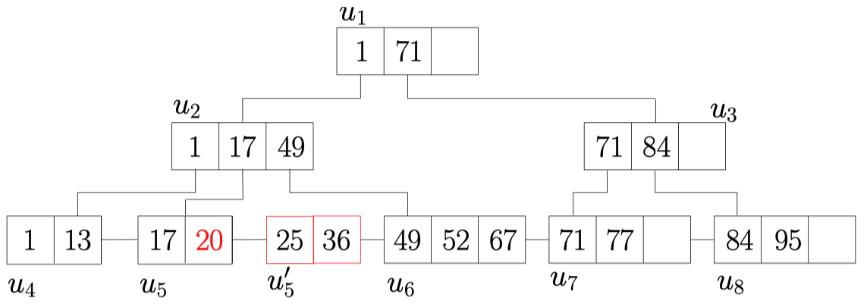
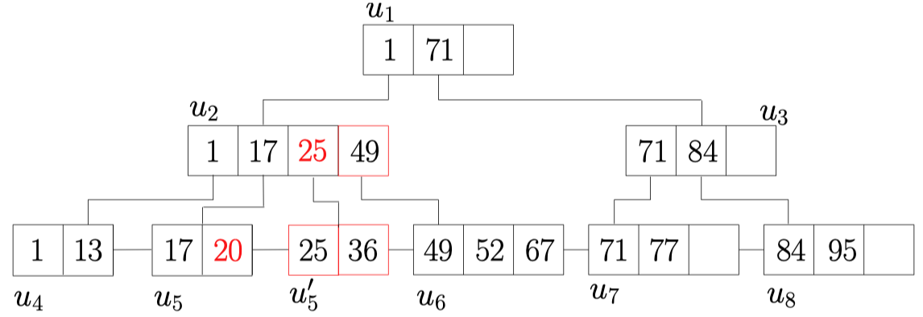
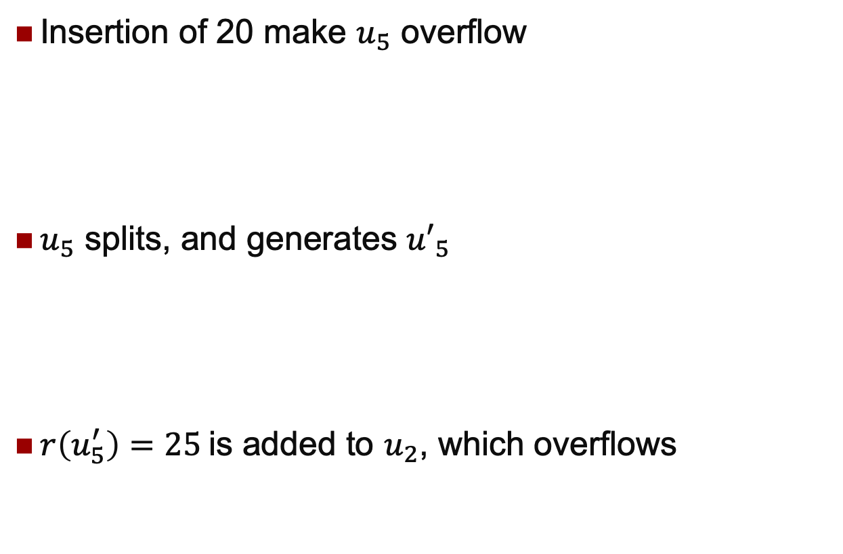
B-Tree Insertion
Insertion of 20 make $u_{5}$ overflow
$u_{5}$ splits, and generates ${u′}_{5}$
$r\left(u_{5}^{′}\right)=25$is added to $u_{2}$, which overflows

Slide 37
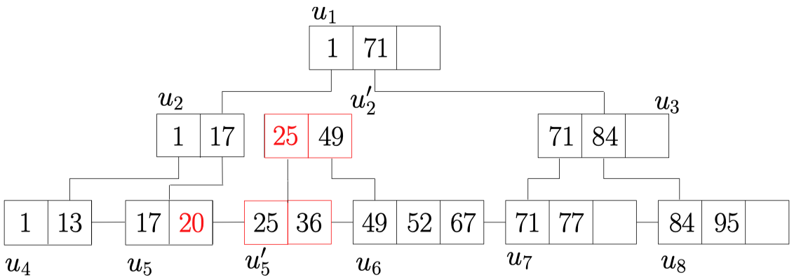
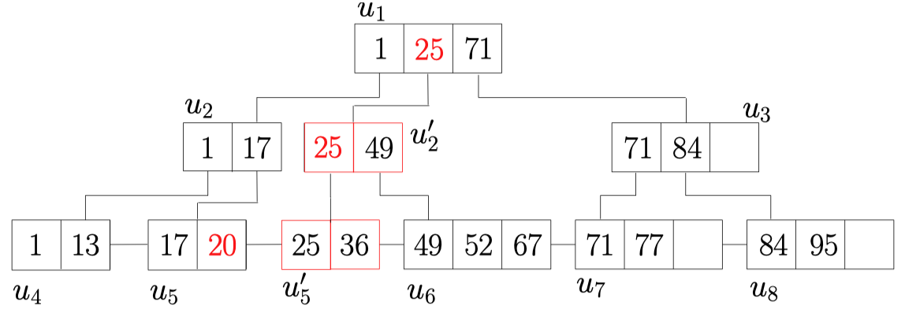
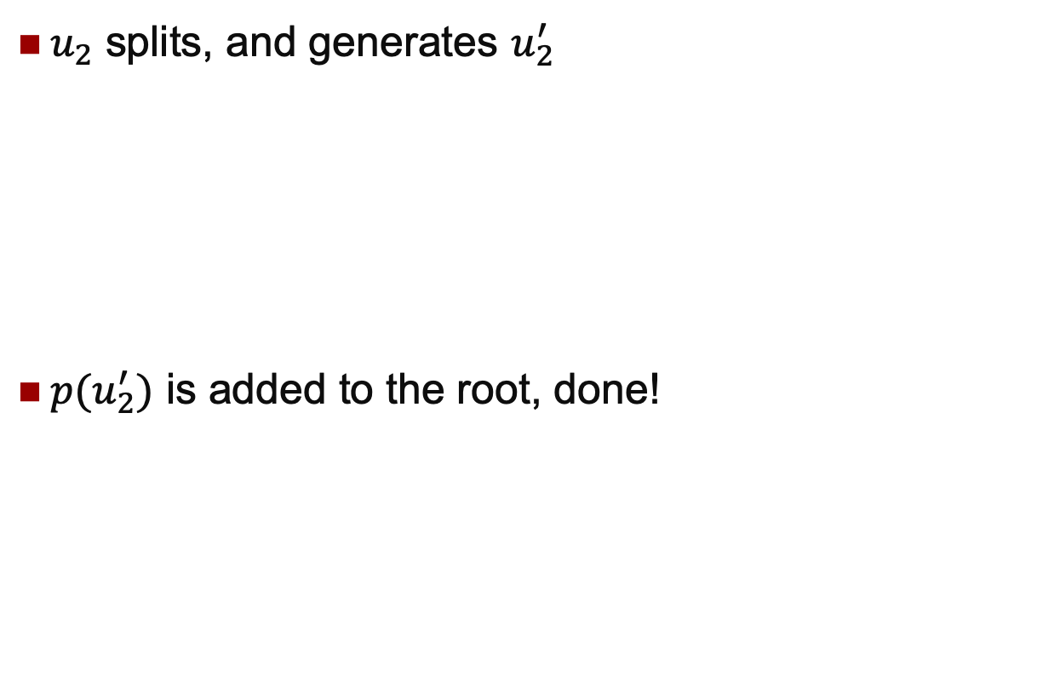
B-Tree Insertion
$u_{2}$ splits, and generates $u_{2}^{′}$
$p(u_{2}^{′})$ is added to the root, done!

Slide 38
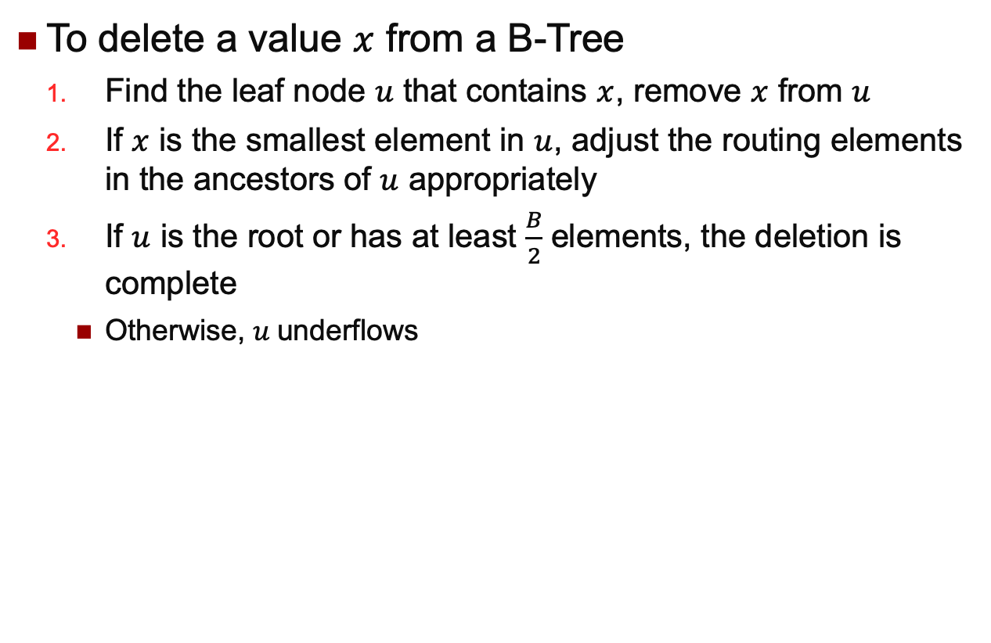
B-Tree Deletion
To delete a value $x$ from a B-Tree
Find the leaf node $u$ that contains $x$, remove $x$ from $u$
If $x$ is the smallest element in $u$, adjust the routing elements in the ancestors of $u$ appropriately
If $u$ is the root or has at least $\frac{B}{2}$ elements, the deletion is complete
Otherwise, $u$underflows

Slide 39
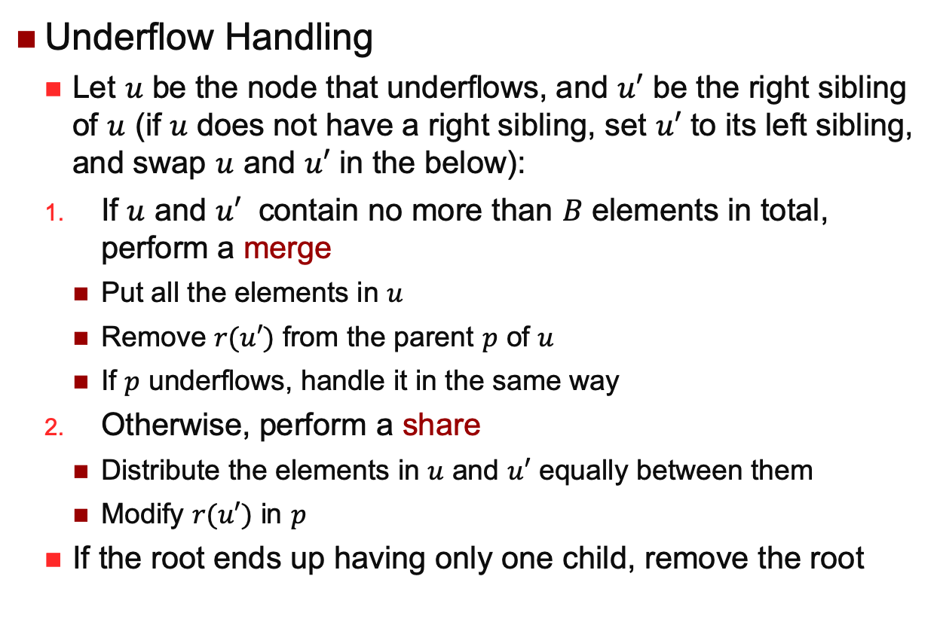
B-Tree Deletion
Underflow Handling
Let $u$ be the node that underﬂows, and $u′$ be the right sibling of $u$ (if $u$ does not have a right sibling, set $u′$ to its left sibling, and swap $u$ and $u′$ in the below):
If $u$ and $u′$ contain no more than $B$ elements in total, perform a merge
Put all the elements in $u$
Remove $r(u′)$ from the parent $p$ of $u$
If $p$ underflows, handle it in the same way
Otherwise, perform a share
Distribute the elements in $u$ and $u′$ equally between them
Modify $r(u′)$ in $p$
If the root ends up having only one child, remove the root

Slide 40
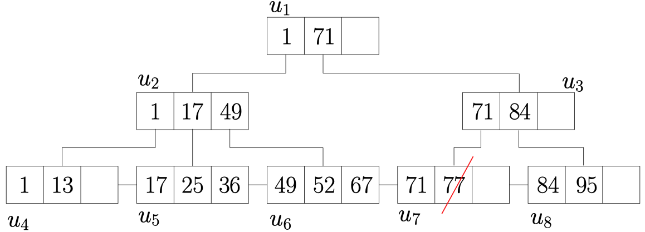
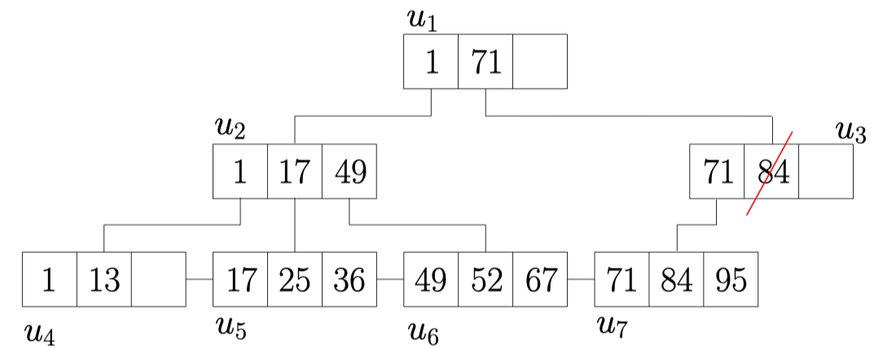
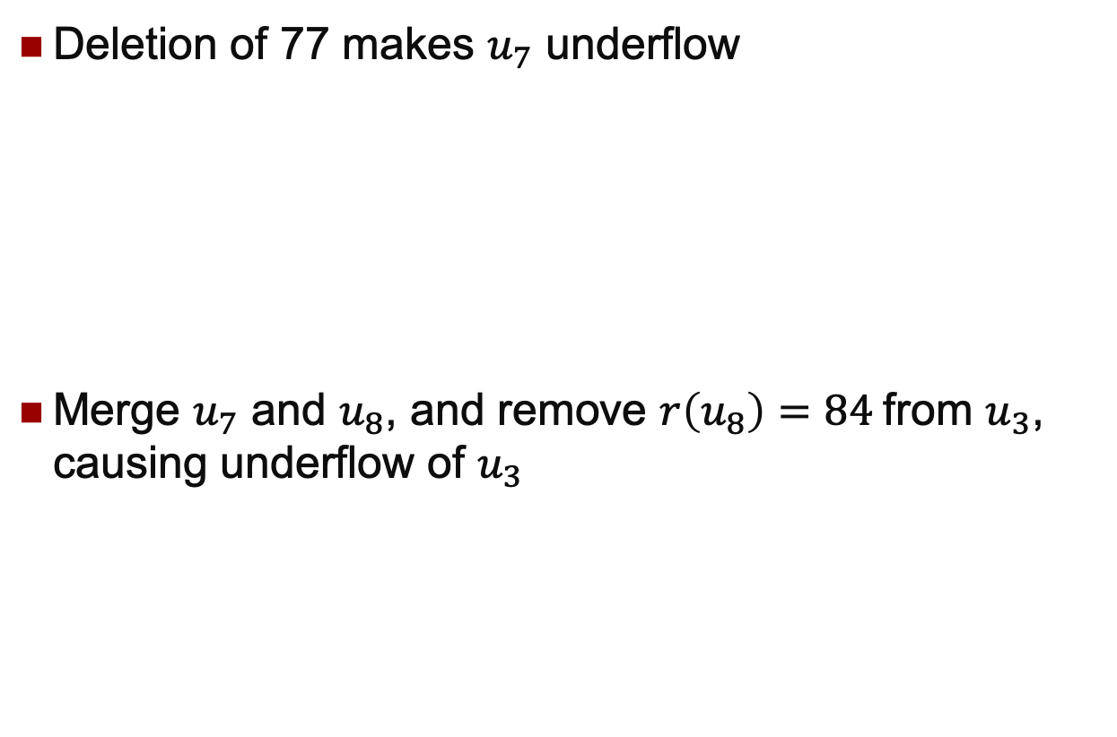
B-Tree Deletion
Deletion of 77 makes $u_{7}$ underflow
Merge $u_{7}$ and $u_{8}$, and remove $r\left(u_{8}\right)=84$from $u_{3}$, causing underflow of $u_{3}$

Slide 41
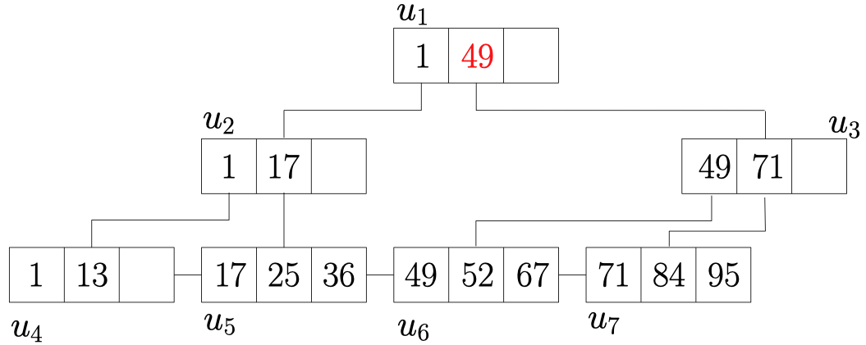
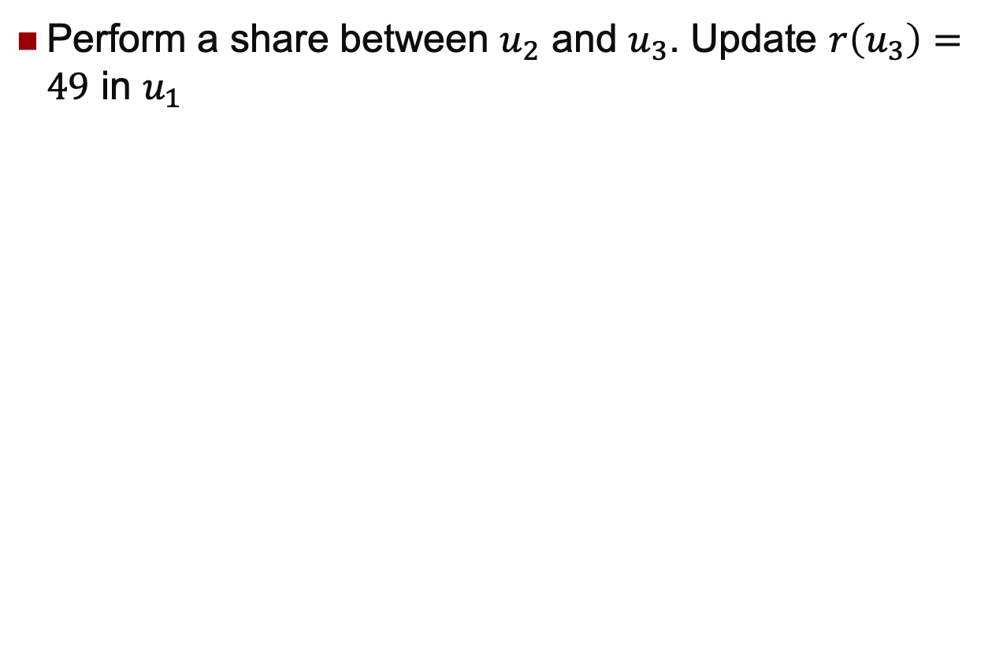
B-Tree Deletion
Perform a share between $u_{2}$ and $u_{3}$. Update $r\left(u_{3}\right)=49$ in $u_{1}$

Slide 42

Bitmap

Slide 43
Bitmap
SID | Name | Gender
6007 | Peter | M
6100 | Ann | F
6107 | Bob | M
6207 | Jane | F
6240 | Suzy | F
6350 | Ben | M
6420 | Peter | M
6500 | Jenn | F
M
1
0
1
0
0
1
1
0
F
0
1
0
1
1
0
0
1

Slide 44
Bitmap
SID | Name | Gender | State
6007 | Peter | M | VIC
6100 | Ann | F | QLD
6107 | Bob | M | NSW
6207 | Jane | F | QLD
6240 | Suzy | F | NSW
6350 | Ben | M | NSW
6420 | Peter | M | QLD
6500 | Jenn | F | VIC
M
1
0
1
0
0
1
1
0
F
0
1
0
1
1
0
0
1
VIC
1
0
0
0
0
0
0
1
QLD
0
1
0
1
0
0
1
0
NSW
0
0
1
0
1
1
0
0

Slide 45
Bitmap
SID | Name | Gender | State
6007 | Peter | M | VIC
6100 | Ann | F | QLD
6107 | Bob | M | NSW
6207 | Jane | F | QLD
6240 | Suzy | F | NSW
6350 | Ben | M | NSW
6420 | Peter | M | QLD
6500 | Jenn | F | VIC
QLD
0
1
0
1
0
0
1
0
SELECT * FROM Students S WHERE S.state = “QLD”
Return the Row_ids of: all “1”s in the “QLD” bitmap
Rows: 2, 4, 7

Slide 46
Bitmap
SID | Name | Gender | State
6007 | Peter | M | VIC
6100 | Ann | F | QLD
6107 | Bob | M | NSW
6207 | Jane | F | QLD
6240 | Suzy | F | NSW
6350 | Ben | M | NSW
6420 | Peter | M | QLD
6500 | Jenn | F | VIC
QLD
0
1
0
1
0
0
1
0
F
0
1
0
1
1
0
0
1
SELECT * FROM Students S WHERE S.state = “QLD” and S.Gender = “F”
Return the Row_ids of: all “1”s in the intersection of “F” and “QLD” bitmaps
Rows: 2, 4

Slide 47
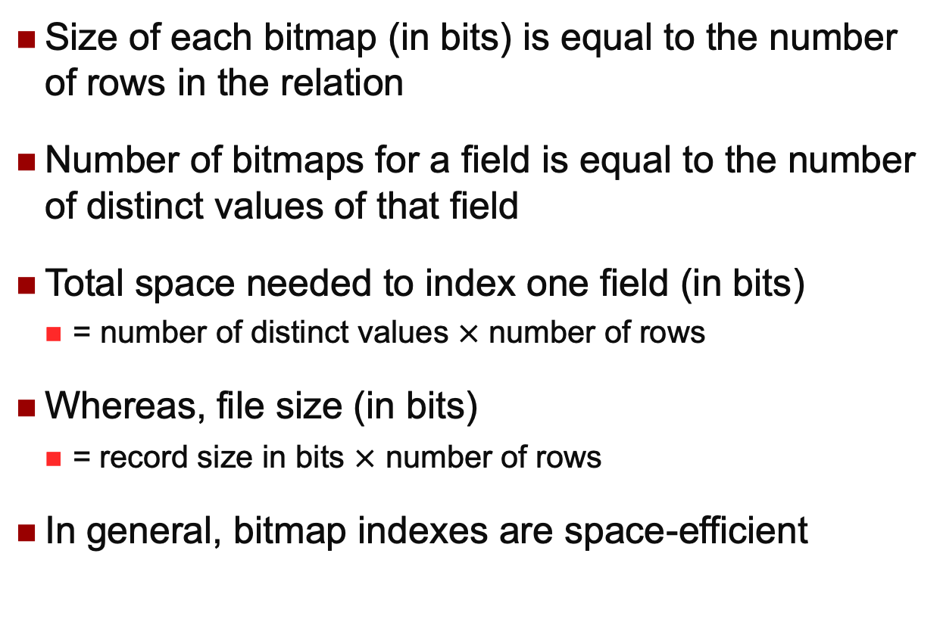
Bitmap Size
Size of each bitmap (in bits) is equal to the number of rows in the relation
Number of bitmaps for a field is equal to the number of distinct values of that field
Total space needed to index one field (in bits)
= number of distinct values $×$ number of rows
Whereas, file size (in bits)
= record size in bits $×$ number of rows
In general, bitmap indexes are space-efficient

Slide 48
Bitmap Limitations
Not good for data that is modified regularly
Updates will require modifying all the associated bitmap indexes
Used in warehouse data sets which are large and are not updated frequently
Mainly for Online Analytical Processing (OLAP)
How to use it to index the spatial data?

Slide 49
Data Access Methods
One Dimensional
Hashing and B-Trees
Line Data
Interval Tree, Segment Tree
Point Data
Hashing: GRID and EXCELL
Hierarchical
Quadtree: Point and Region Quadtrees
kd-Tree
Z-values and B-tree
Polygon Data
Transformation: End point mapping and z-values
Overlapping: R-tree and R*-tree
Clipping: R⁺-tree

Slide 50
Line Data
Arbitrary direction and shape
Use MBR and treat like polygons
Treated as trajectory data
Straight line segments with perpendicular directions
Align parallel the axis
Interval Tree
Straight line segments with different directions
Use Point Index techniques to index the two end points separately
Segment Tree

Slide 51
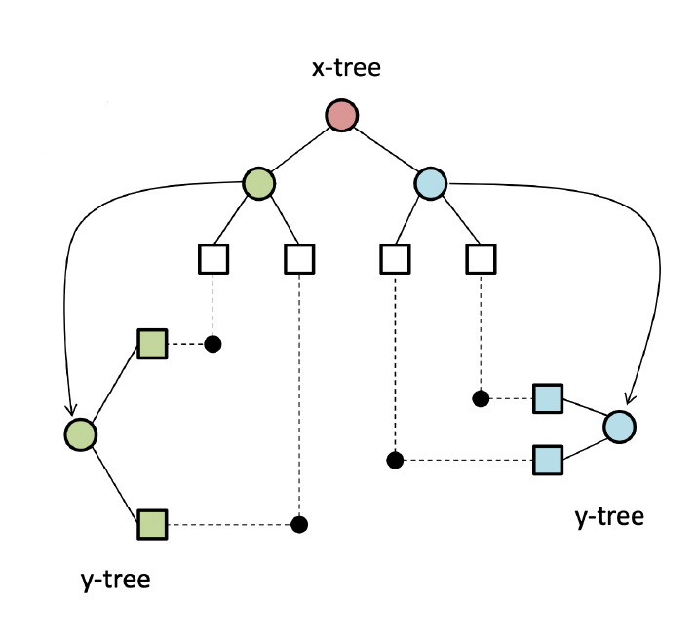
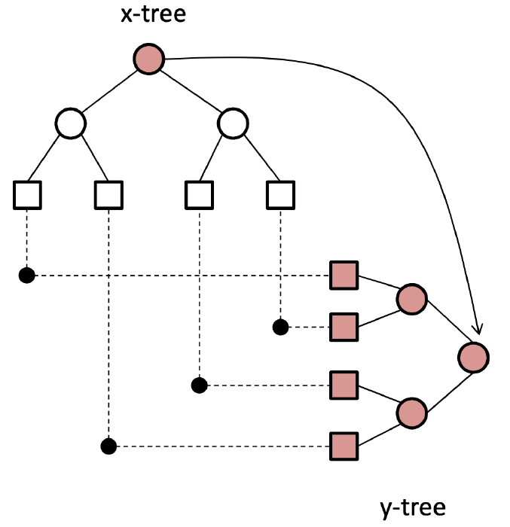
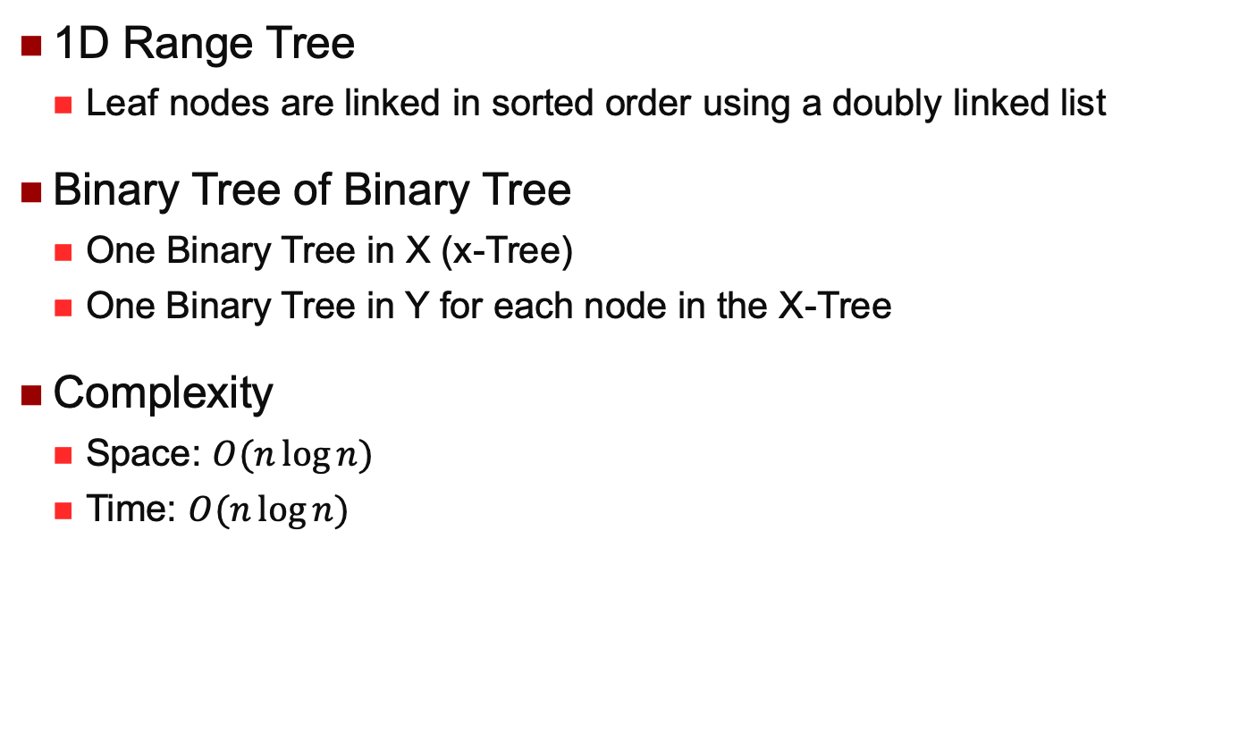
2D Range Tree
1D Range Tree
Leaf nodes are linked in sorted order using a doubly linked list
Binary Tree of Binary Tree
One Binary Tree in X (x-Tree)
One Binary Tree in Y for each node in the X-Tree
Complexity
Space: $O(n\log{n})$
Time: $O(n\log{n})$

Slide 52
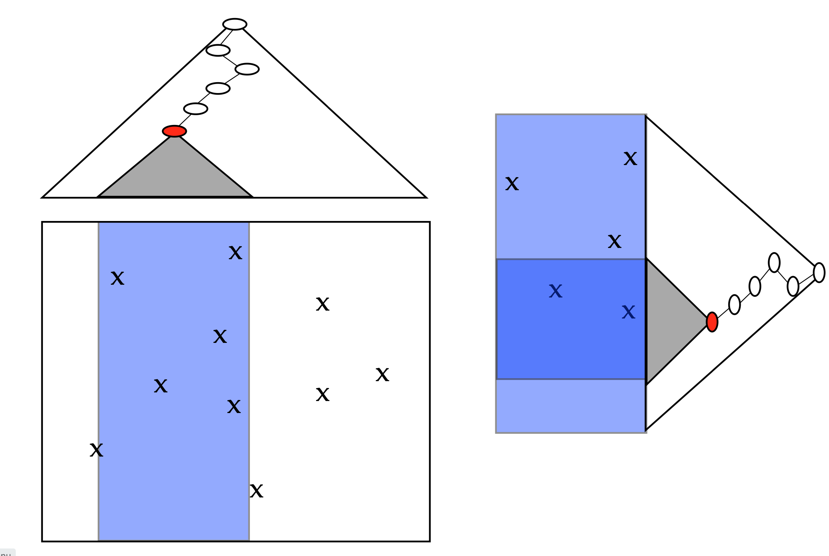
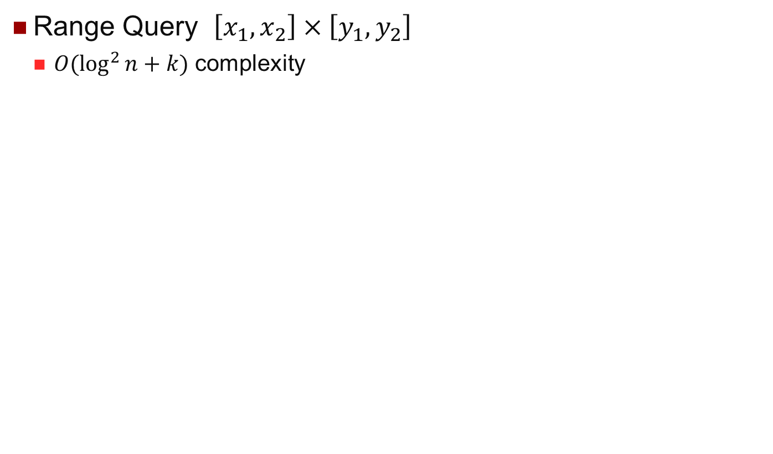
2D Range Tree Search
Range Query $\left[x_{1},x_{2}\right]×\left[y_{1},y_{2}\right]$
$O(\log^{2}{n}+k)$ complexity

Slide 53
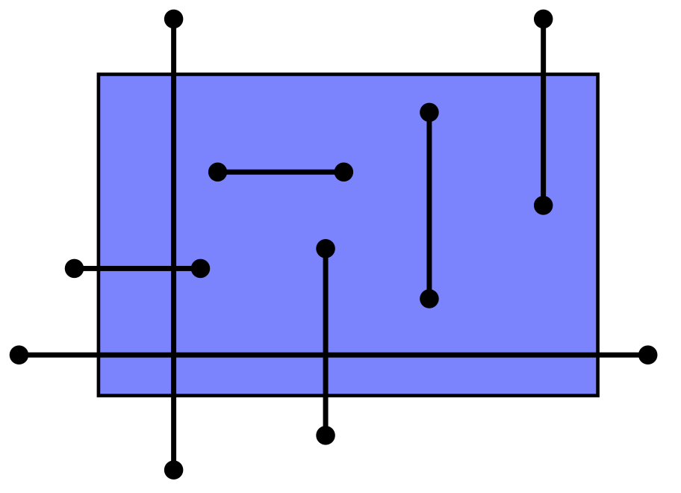
Interval Tree
Axis-Aligned segments
Range Query
Return all segments that have any part of them inside the rectangle
Wiring Diagrams, Genes on genomes

Slide 54
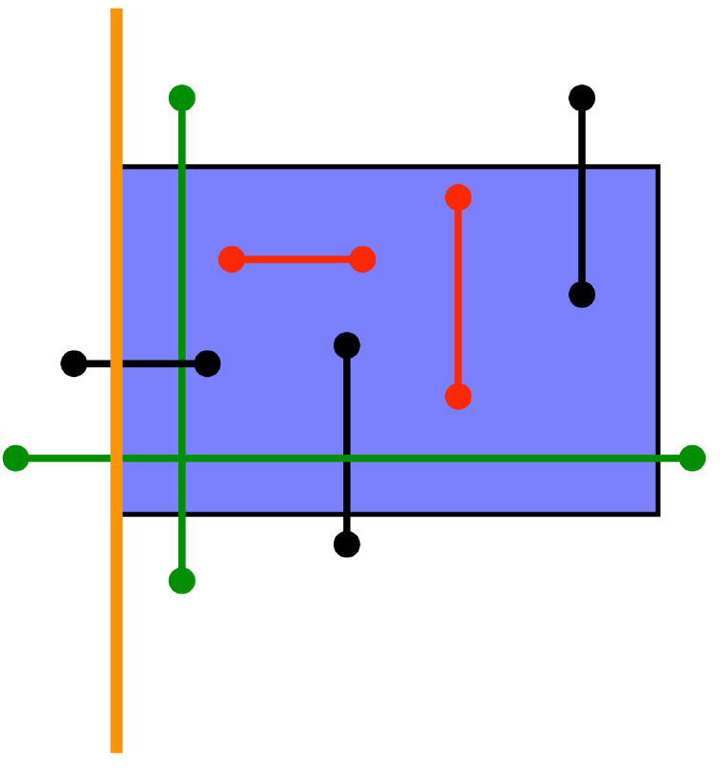
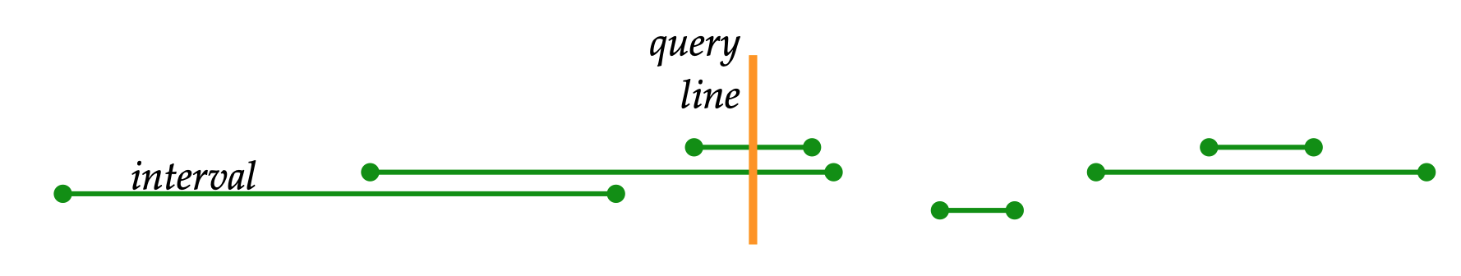
Interval Tree
Segments with at least one endpoint in the rectangle
Black lines and Red lines
2D Range Tree
Any point index structures
Segments with no endpoints in the range
Green lines
Consider just horizontal segments
They must cross a vertical side of a the region
Subproblem
Given a vertical line, find segments that it crosses
Y is irrelevant for this subproblem

Slide 55
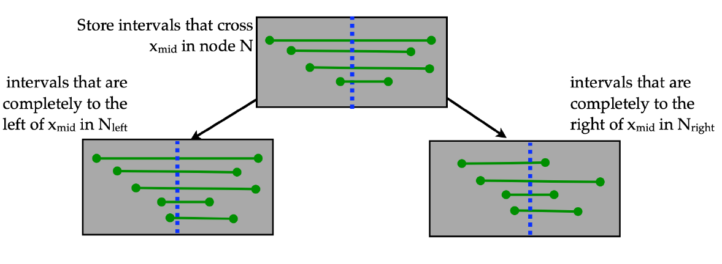

Interval Tree Construction
Recursively build tree on intervals as follows:
Sort $2n$endpoints
$x_{mid}$ is the median point
Store the intervals crosses $x_{mid}$
Left child: intervals completely smaller than $x_{mid}$
Right end point smaller than $x_{mid}$
Right child: intervals completely larger than $x_{mid}$

Slide 56


Interval Tree Construction
Store $x_{mid}$ with each node
Approximately balanced because by choosing the median, we split the set of end points up in half each time
Height is $O(\log{n})$
$O\left(n\right)$ Storage
Each interval stored once
Fewer than $n$ nodes (each node contains at least one interval)
$O(n\log{n) }$Construction time

Slide 57


Interval Tree Search
Query $x_{q}:$ a vertical line
Suppose we are at node N
If $x_{q}<x_{med},$skip the right subtree
If $x_{q}≥x_{med},$skip the left subtree
Always have to search the intervals stored at current node
$logN$nodes to check

Slide 58




Interval Tree Search
Current Node Search
Store each interval in two sorted list stored at node
List $L$ sorted by increasing left endpoint
List$R$ sorted by decreasing right endpoint
Search List depending on which side of $x_{med}$ the query is on
If $x_{q}<x_{med}$, search $L$, output all until a left endpoint $>x_{q}$
If $x_{q}≥x_{med}$, search $R$, output all until a right endpoint $<x_{q}$
It works because we know each segment intersects $x_{med}$

Slide 59


Interval Tree
Vertical Segment Search
Instead of infinite vertical lines, we have finite segments as query
Somehow have to remove the ones that don’t satisfy the $y$-constraints
Interval trees $→$ candidates
How to remove the ones that don’t satisfy the $y$-constraints?

Slide 60


Interval Tree
Vertical Segment Search
Use 2D Range Tree instead of sorted lists to hold segments at each node
Execute a range query on a semi-inﬁnite range on the 2d-range tree on the end points stored at each node of the interval tree.
Two range trees $R_{left}$and $R_{right}$ that store points to the left and to the right of $x_{mid}$
Time complexity
$O\left(\log^{3}{n+k}\right)$ with two trees
$O\left(\log^{2}{n+k}\right)$ with fractional cascading
Space complexity
Each interval stored at one node
Total space for the range trees is $O(nlog n)$

Slide 61

Priority Search Tree
Space Complexity $O(n)$
1-Side Range Query
$\left[−∞,x\right], [y_{1},y_{2}]$
Easy in 1D
Just walk the sorted list from left to right or right to left
2D: $x<20$ and $25<y<70$
Somehow integrate the the information about $y$-coordinate in the structure

Slide 62




Priority Search Tree
1-Side Range Query
$\left[−∞,x\right], [y_{1},y_{2}]$
Find the highest/lowest value of $x$
Heap
Freedom in how to partition the set into 2 subsets
Find the range of $y$
Binary Search Tree
Combine them!
Priority Search Tree

Slide 63

Priority Search Tree
Construction
Given a set of points $P$
$p_{minx}$ is the one with the smallest $x$
$y_{mid}$: median of the $y$-coordinates of $P/\{p_{minx}\}$
Store point $p_{minx}$ and $y_{mid}$ in a node N
$y_{mid}$ does not need to correspond to point $p_{minx}$
Split the points by $y$-coordinate
$P_{left}$=$\left\{p∈P\backslash \{p_{minx}\right\} and p.y≤y_{mid}$}
$P_{right}$=$\left\{p∈P\backslash \{p_{minx}\right\} and p.y>y_{mid} \}$
Recursively build left/right subtrees
$O(n logn)$

Slide 64


Priority Search Tree
Construction
Binary tree on $y$
Each sub-tree is a heap on $x$

Slide 65


Priority Search Tree
Search
Range search for $y$ can be done in a 1-d range tree
Points in the grey sub-trees all satisfy the $y$-constraints
Points along the search paths may or may not
Must check them
Each result sub-tree is a heap
Output the tops of the heap
$O(logn+k)$

Slide 66


Segment Tree
Arbitrarily Oriented Segments
No longer assume they are parallel to the axes
Store the bounding boxes of each segment as a collection of 4 axis-parallel segments?
How to handle range queries on these kinds of segments
If a vertical line crosses a segment, it crosses its MBR
It may be that a vertical segment crosses a bounding box but doesn’t cross the segment
Vertical Segment Stabbing Query
Return all segments that intersect a vertical query segment
Assume segments don’t cross

Slide 67


Segment Tree
Interval Tree?
No longer true that a query like $[−∞, x]$by $[y_{1} , y_{2} ]$will ﬁnd the endpoints of satisfying segments

Slide 68


Segment Tree
Binary Search Tree
Recursively partitions 1D space
Each leaf stores an elementary region
For internal node $u$, $Region\left(u\right)$ is the union of elementary regions in the subtree rooted at $u$
The space is divided into a set of basic units
Every segments is the union of some units

Slide 69


Segment Tree
Store the segments in the Binary Search Tree
Store the segment $s$ at any node $u$ that
Segment covers the entire $Region(u)$
It doesn’t cover the entire $Region(Parent(u))$
Propagate segments up until we reach a node whose Region is not a subset of the segment
Segments may be stored at several nodes
Each segment is stored at most twice at each level

Slide 70

Segment Tree
Vertical Line Query
Find the segment that intersect a given $x$
Binary search
Output every segment stored at the current node
If $x$ falls into $Region\left(leftchild\left(u\right)\right),$ take the left branch
Else if $x$ falls into $Region\left(rightchild\left(u\right)\right),$ take the right branch

Slide 71

Segment Tree
Construction
Sort the segments
Break into units
Build balanced BST on them
Insert the segment $(x_{1},x_{2},u)$
If $Region\left(u\right)⊂\left[x_{1},x_{2}\right],$ $u.insert(x_{1},x_{2})$
If $\left[x_{1},x_{2}\right]$ intersects $Region(u.left)$
Insert($x_{1},x_{2},u.left$)
If $\left[x_{1},x_{2}\right]$ intersects $Region(u.right)$
Insert($x_{1},x_{2},u.right$)

Slide 72


Segment Tree
Vertical Segment Stabbing Query
Segments stored at$u$ all span $Region(u)$ by definition
The segments can be linearly ordered from top to bottom
Index them in binary search tree
Range query between $y_{1}$ and $y_{2}$
$O(\log^{2}{n+k})$

Slide 73
Data Access Methods
One Dimensional
Hashing and B-Trees
Line Data
Interval Tree, Segment Tree
Point Data
Hashing: GRID and EXCELL
Hierarchical
Quadtree: Point and Region Quadtrees
kd-Tree
Z-values and B-tree
Polygon Data
Transformation: End point mapping and z-values
Overlapping: R-tree and R*-tree
Clipping: R⁺-tree

Slide 74


Grid File
Basic idea
Superimpose a $k$-dimensional grid on the space
Only scan the data in a grid
Essentially, a 2D hash function
Cells can be of varying sizes
Cell-to-bucket mapping: many-to-1
What about 1-to-many?
The grid definition (scales) is kept in memory
The grid directory is kept on disk
Motivation
Fixed-grid not suitable for non-uniformly distributed data

Slide 75
Grid File
To answer a point query:
Use the scales to locate the cell
Read the cell from disk
The loaded cell contains a reference (pointer) to data bucket
Read data bucket
On average two disk accesses
To answer a range query:
Examine all cells that overlap the search region
Read the corresponding data buckets(s)

Slide 76
Grid File
To insert a point:
Search (point query) the matching cell and data bucket
If there is sufficient space, insert into data bucket
Else: add a vertical or horizontal line to split, if necessary, and move data accordingly
To delete a point:
Search …
Merge if necessary
Problems:
Have to remember all the definitions of the grids
Why not uniformally?

Slide 77
EXCELL
EXtendible CELL
Motivation
Fixed grid is easier to manage and more efficient to use
Basic Ideas
All cells are of the same size
No need to keep grid definition (scales) in memory
But it’s still necessary to remember how to map grid cells to buckets
p₈
p₇
p₆
p₃
p₂
p₁
p₅
Data buckets
Capacity = 3

Slide 78
EXCELL
Search:
Efficient for point and range queries
To insert a point:
Search (point query) the matching cell and data bucket
If there is sufficient space, insert into data bucket
Else: add a vertical or horizontal line to split, if necessary, and move data accordingly
When split, the number of cells is doubled

Slide 79
Data Access Methods
One Dimensional
Hashing and B-Trees
Line Data
Interval Tree, Segment Tree
Point Data
Hashing: GRID and EXCELL
Hierarchical
Quadtree: Point and Region Quadtrees
kd-Tree
Z-values and B-tree
Polygon Data
Transformation: End point mapping and z-values
Overlapping: R-tree and R*-tree
Clipping: R⁺-tree

